Slide 1
Modelling and Inversion of AEM data

Slide 2
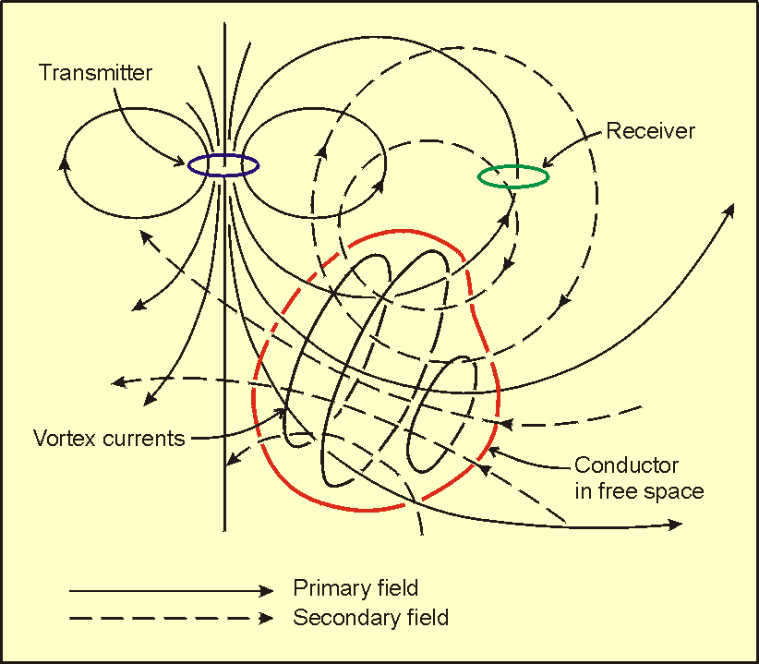
Physics of Electromagnetic Method for time varying magnetic fields .

Slide 3
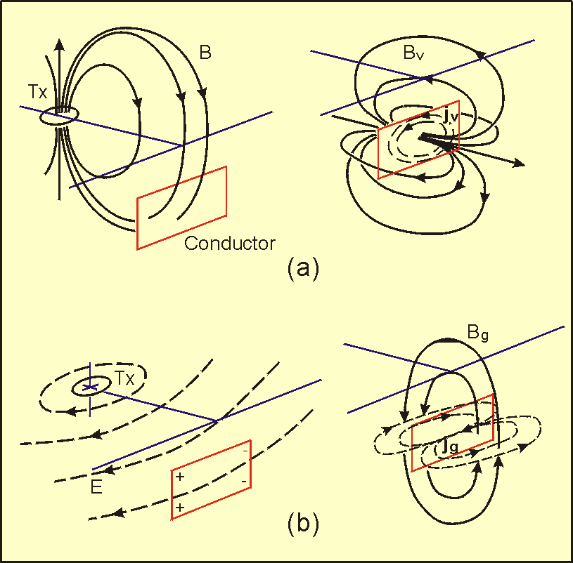
Induced currents are interactive and modify each other .

Slide 4
Maxwell’ s Equations for time varying electric ( E ) and magnetic ( H ) fields .
,
(Faraday’s Law )
(Ampere’s Law )
( un-named )
( Gauss’s Law )
Four differential equations' are coupled and for most cases only numerical solutions can be used to calculate the E and H fields .

Slide 5
Maxwell Equations Solutions
. Solutions for 1D ( layered ) section are analytic(formula) .
. 2.5 D ( 2D section , 3D source ) solutions are numerical .
. 2.5 D solutions utilize the the Finite Element Method ( FEM )
In contrast to potential field ( static Magnetic and Gravity ) these solutions are complex
because the solutions are required for interacting sources for the measured magnetic field ( currents ) , and for the terms which link the currents to the measured magnetic field .These quantities are model (conductivity ) and transmitter location dependent .

Slide 6
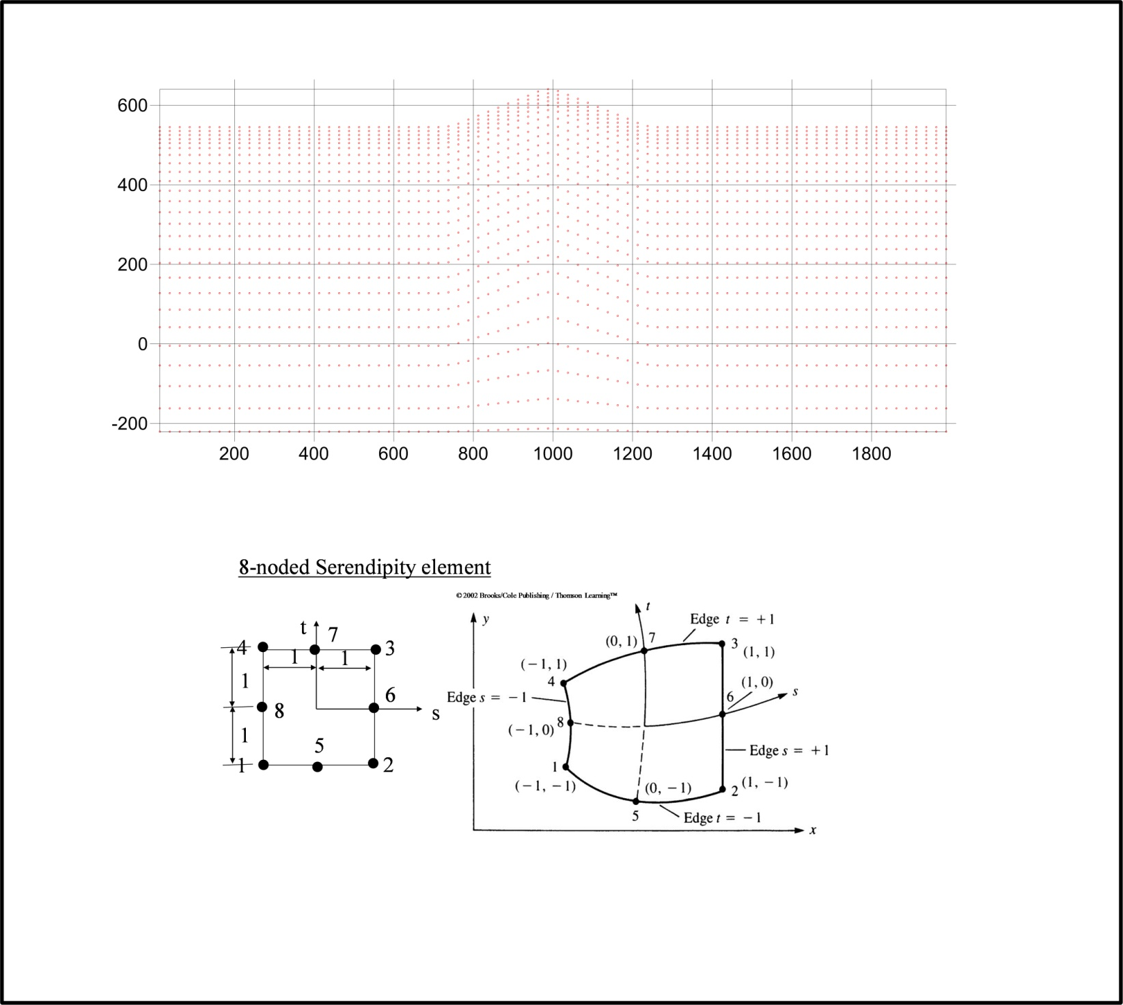
Maxwells Equations in FEM
Model constructed from cells ( mesh elements ) assigned resistivity values .
At each elements 8 nodes , solutions for E and H fields obtained .
There are 16 unknowns for each element

Slide 7
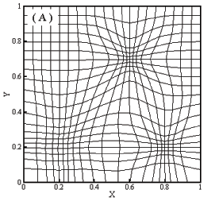
2.5 D Maxwells Equations in FEM
1
2
3
Fields inside each element are estimated using a set of 8 polynomials related to solutions for E and H fields at 8 nodes .
8
4
Element size has to be sufficiently small so that EM fields are accurately evaluated inside the element . Greater conductivities require smaller cell sizes .
7
6
5
Solutions require solving for 10’s of thousands unknowns for each transmitter location ( station ) and frequency ( time ) . To achieve reasonable processing times this necessitates paralleling the code on multiprocessor units and using specialized solvers for matrix operations .

Slide 8



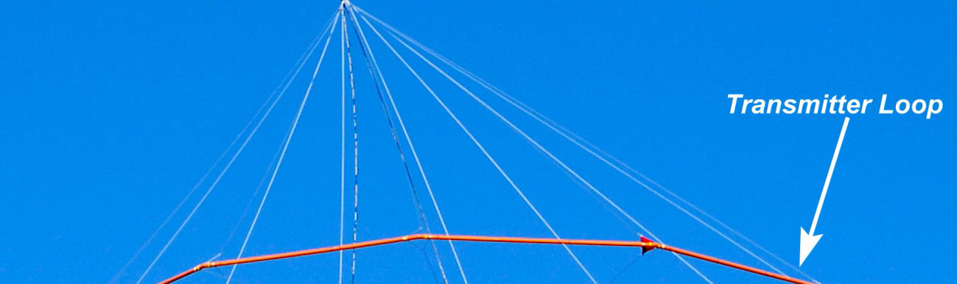


Slide 9
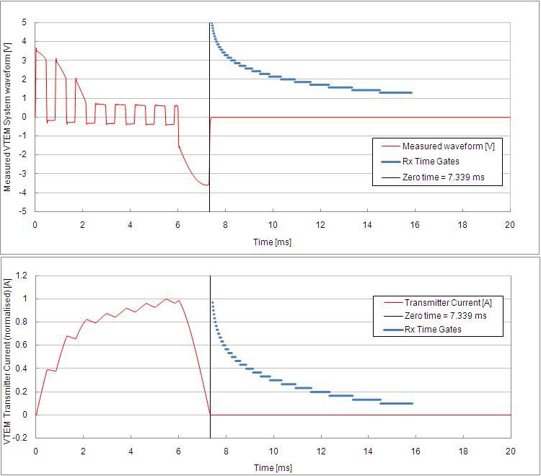
,

Slide 10
,
Early Time
Medium Time
Late Time
Propagation of Electric Field( Induced Current ) in a half space .

Slide 11
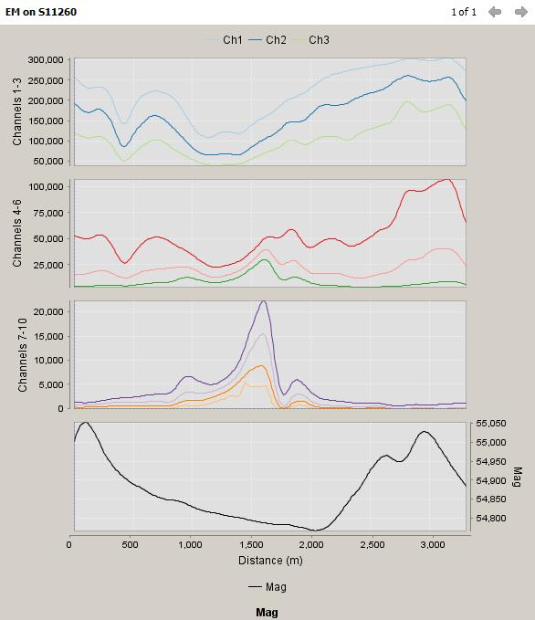
Spectrem EM : Line 11260
,

Slide 12
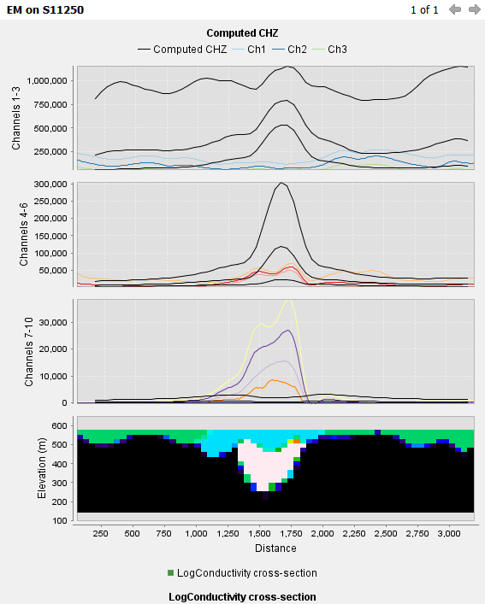
Spectrem EM Forward Model : Line 11250
,

Slide 13
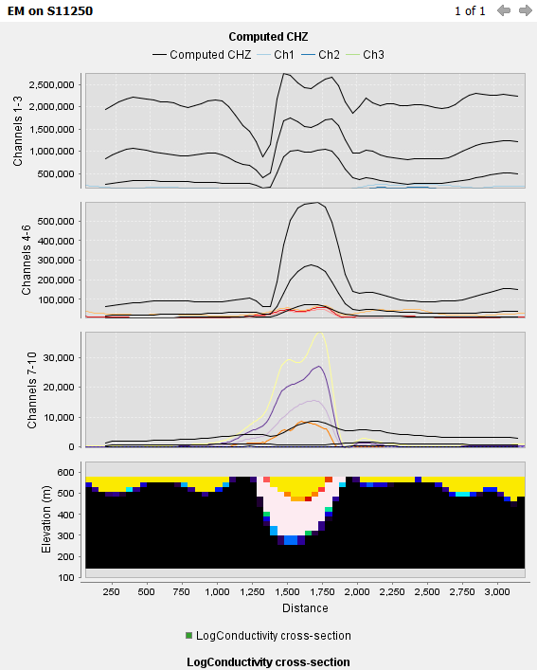
Spectrem EM Forward Model : Line 11250
,

Slide 14
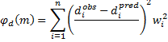
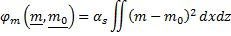
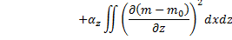
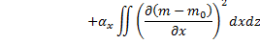
Inversion method
Objective function
Data misfit
Model Roughness / Model Norm

Slide 15
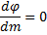
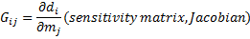
Minimize
We want
Solution is

Slide 16
Inversion Strategy at each iteration
. Forward model and Sensitivity Matrix Calculated
. Data Misfit obtained
. Analysis of Sensitivity Matrix results in ordering parameters in
terms of their importance or sensitivity to data .
. Use Relative Singular Value Truncation ( RSVT ) parameter
to damp changes in parameters ordered by their sensitivity to data ( Estimate regularization parameter beta ).
. If updated model results in reduction in data misfit start new iteration
with a reduced RSVT parameter ( less damping )

Slide 17
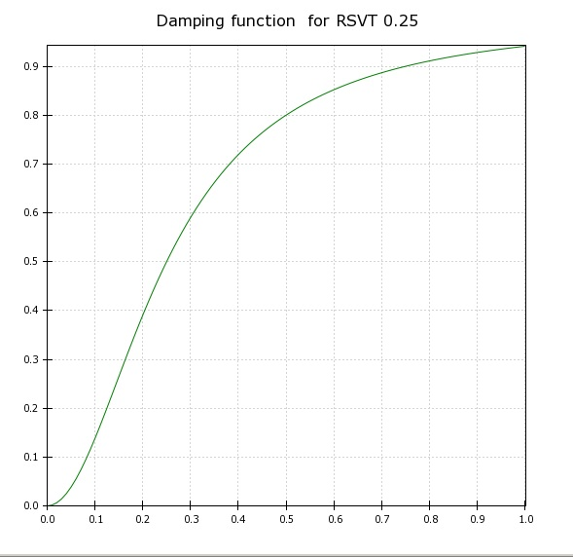
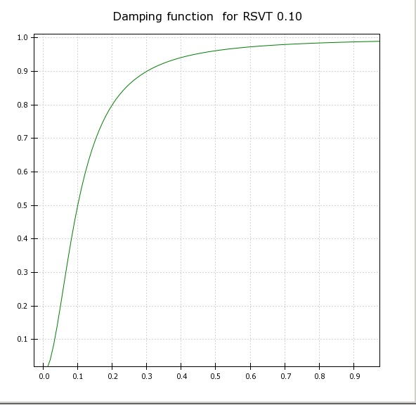
RSVT parameter damping functions
Parameter Importance
Parameter Importance

Slide 18
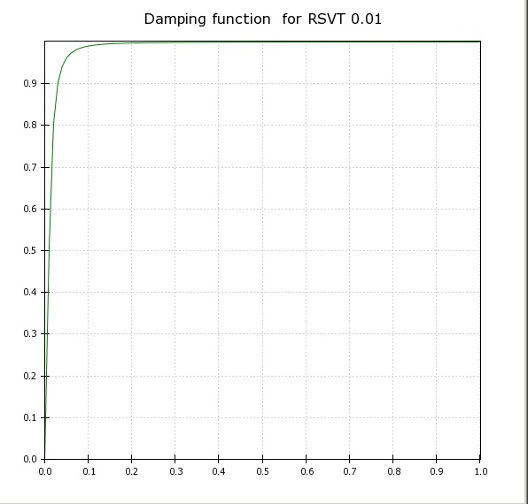
RSVT parameter damping functions
Parameter Importance
Parameter Importance

Slide 19
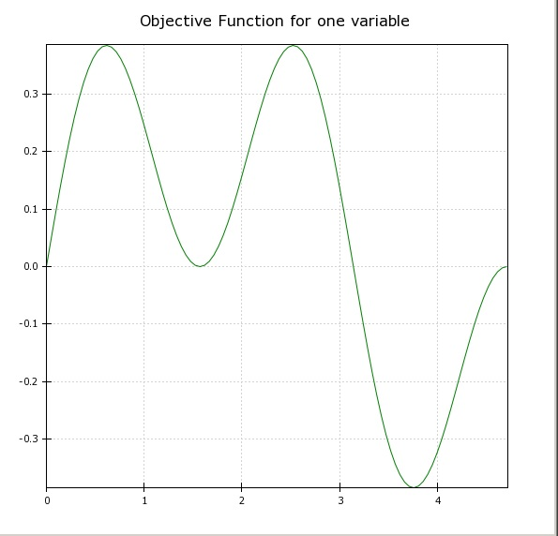
How does inversion algorithm work ?

Slide 20
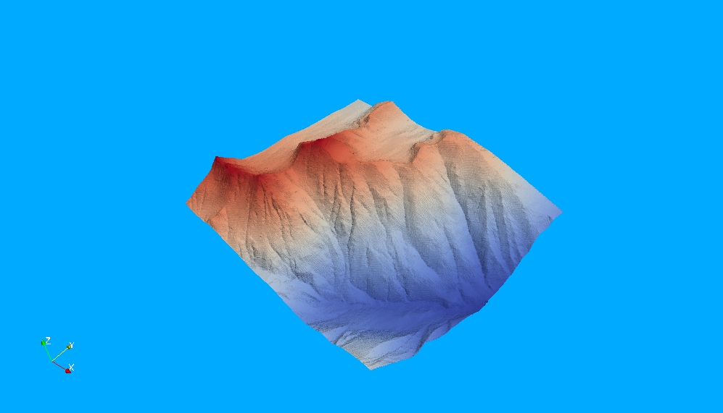
Objective ( Error ) Function for two variables

Slide 21
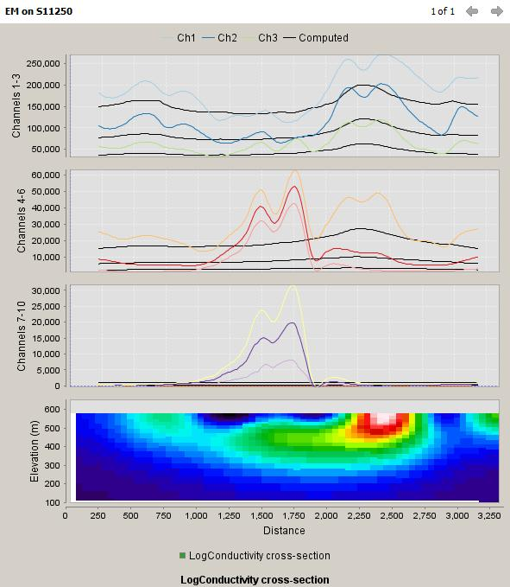
Iteration 1

Slide 22
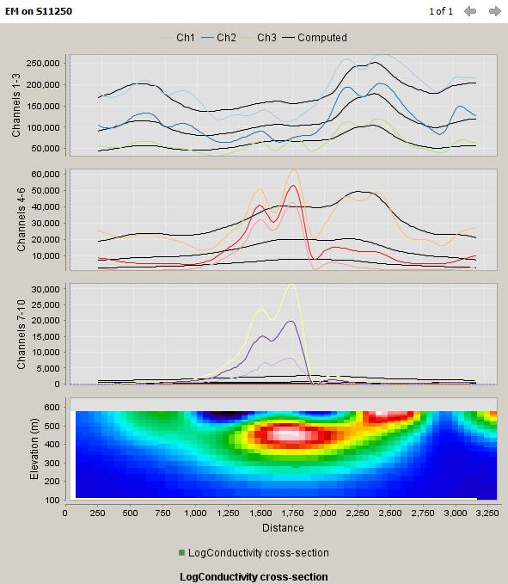
Iteration 3

Slide 23
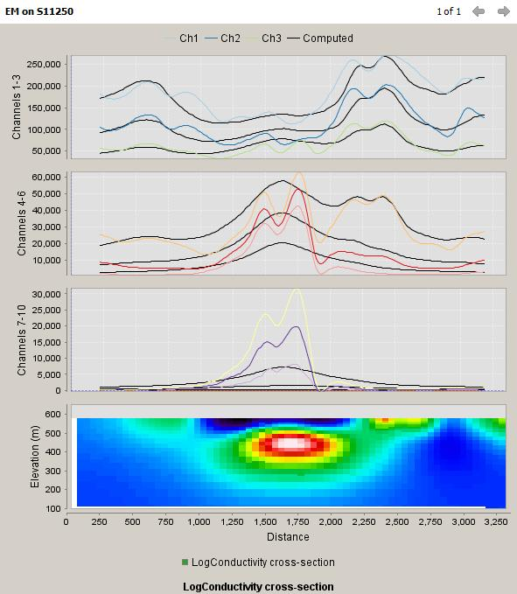
Iteration 5

Slide 24
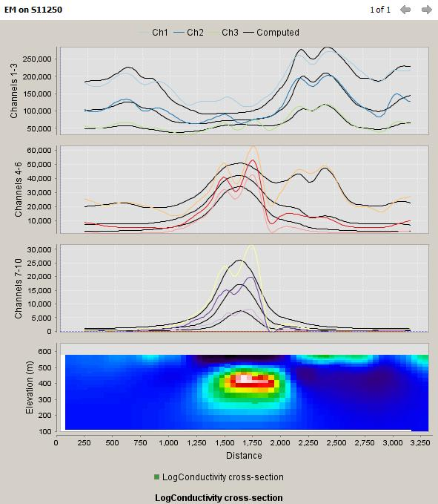
Iteration 10

Slide 25
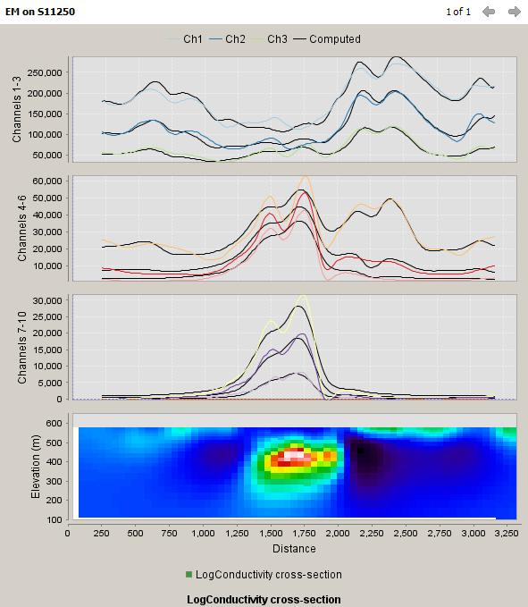
Iteration 15

Slide 26
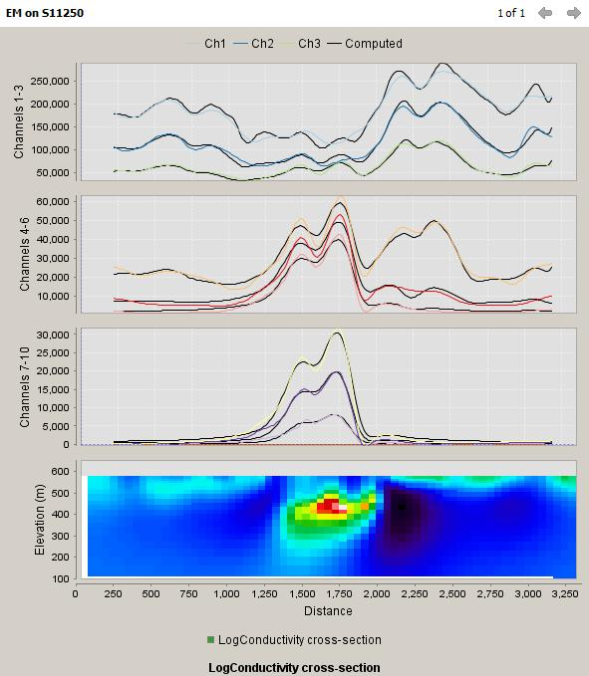
Iteration 20

Slide 27
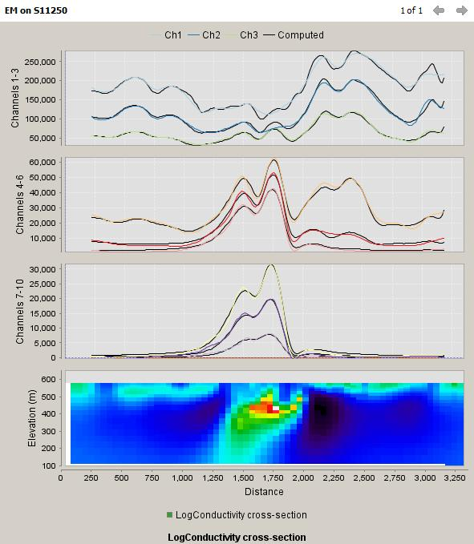
Iteration 30

Slide 28
Spectrem EM Forward Model : Line 11250
,

Slide 29
,
Inverting simultaneously with X and Z components

Slide 30
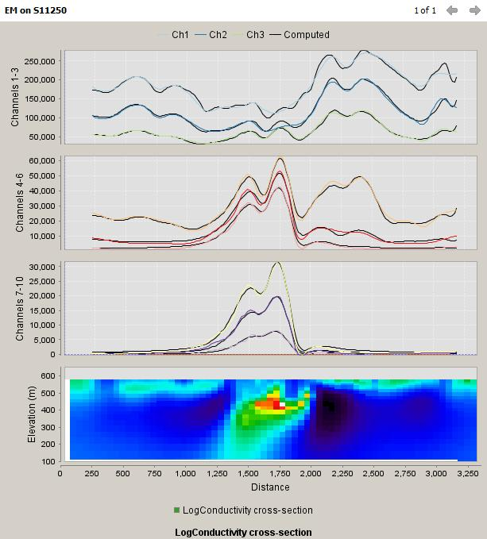
Z Component only
,

Slide 31
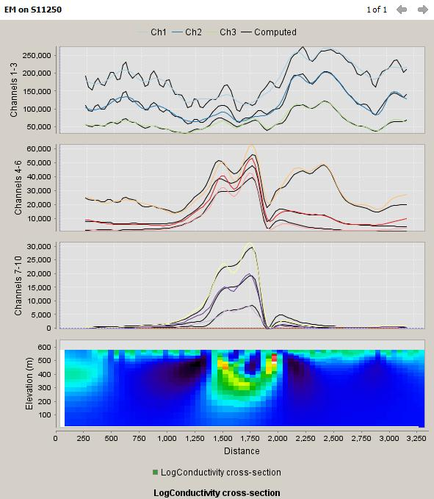
X and Z Components
,

Slide 32
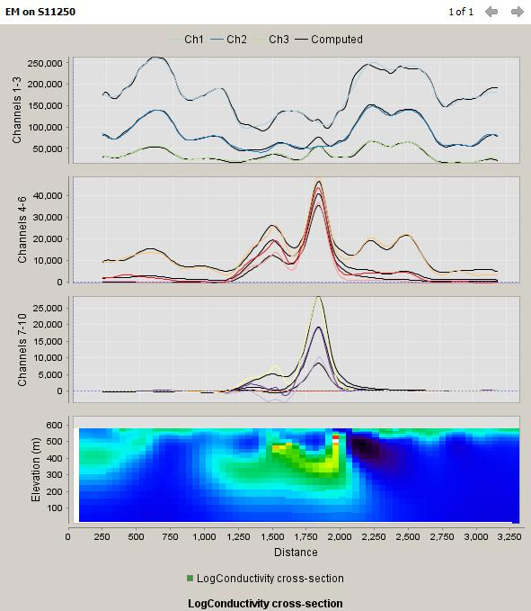
X Component only
,

Slide 33
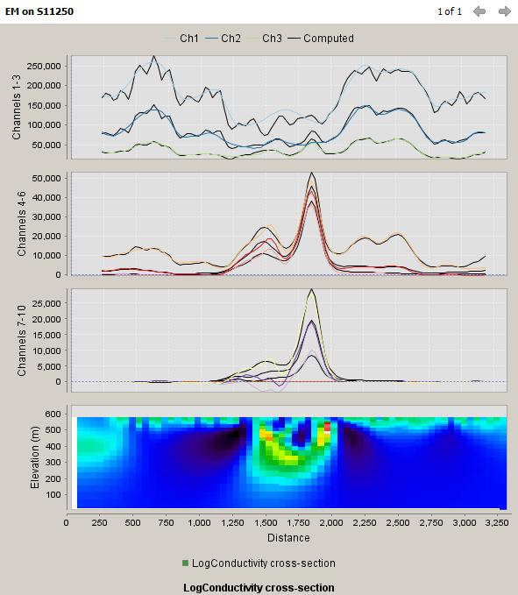
X and Z Components
,

Slide 34
Z Component only
,
Iteration 10
Iteration 25

Slide 35
,
. Whenever possible inversion should always be using X and Z Components .
. This will result in a longer ( almost twice ) processing time .
. In some cases data quality ( particularly X ) may not permit this .

